Slide 1
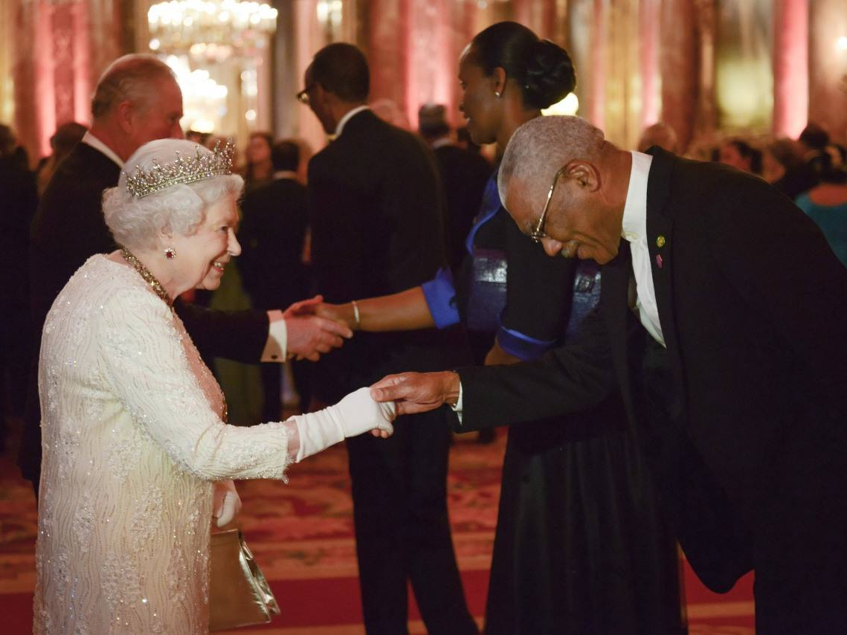
To bow or not to bow.
That is the question.

Slide 2
Does the US president bow to a foreign king or queen?
1) ‘No title of nobility shall be granted by the United States.’ No nobility exists & no one has to bow to anyone.
The President and a king are “equals as heads of state” so neither would actually bow to the other.
2) In unofficial situations, following the etiquette of another culture when in their domain is respectful. So a bow does not indicate one is a subject: it just means one is a respectful guest.
Notes:
http://www.formsofaddress.info/King_Queen.html

Slide 3
A PERSONAL MEETING WITH A KING
GICF 14 December 2019
Notes:
Not a religious ritual – Go to Bethlehem at Christmas. (or even come to GICF at Christmas)

Slide 4
Protocol Requirements for meeting the King
Leaving
Believing
Correction
Practical Worship
Guidance from the HS

Slide 5
Matthew 1:1-12
1 Now after Jesus was born in Bethlehem of Judea in the days of Herod the king, behold, wise men from the East came to Jerusalem, 2 saying, “Where is He who has been born King of the Jews? For we have seen His star in the East and have come to worship Him.”

Slide 6
Matthew 1:1-12
3 When Herod the king heard this, he was troubled, and all Jerusalem with him. 4 And when he had gathered all the chief priests and scribes of the people together, he inquired of them where the Christ was to be born.
5 So they said to him, “In Bethlehem of Judea, for thus it is written by the prophet:

Slide 7
Matthew 1:1-12
6 ​‘​But you, Bethlehem, in the land of Judah, ​​are not the least among the rulers of Judah; ​​For out of you shall come a Ruler ​​Who will shepherd My people Israel.’ ”​
7 Then Herod, when he had secretly called the wise men, determined from them what time the star appeared.

Slide 8
Matthew 1:1-12
8 And he sent them to Bethlehem and said, “Go & search carefully for the young Child, and when you have found Him, bring back word to me, that I may come and worship Him also.”
9 When they heard the king, they departed; and behold, the star which they had seen in the East went before them, till it came & stood over where the young Child was.

Slide 9
Matthew 1:1-12
10 When they saw the star, they rejoiced with exceedingly great joy. 11 And when they had come into the house, they saw the young Child with Mary His mother, and fell down and worshiped Him. And when they had opened their treasures, they presented gifts to Him: gold, frankincense, and myrrh.

Slide 10
Matthew 1:1-12
12 Then, being divinely warned in a dream that they should not return to Herod, they departed for their own country another way.

Slide 11
1. Leaving
V1 – Departure, Distance, Difficulties, Discomfort
wise men from the East came to Jerusalem
Distance. Susa (Persia) to Jerusalem ~ 765 miles (The term wise men is used when Daniel was in Babylon & in Susa.)
How far have you come today?
What did you have to leave behind to seek Jesus?
What difficulties have you faced along the way?
Notes:
Could be anywhere – India, China, etc.

Slide 12
The correct protocol for a meeting with the King is LEAVING something behind to come to Him

Slide 13
2. Believing
V2 – Faith
For we have seen His star in the East and have come to worship Him
You followed a what?
What about cloudy nights? The star was not always visible (see v10)
Did they feel clear about the direction/purpose? Faith kept them going!
Notes:
No one appears to have doubted their story

Slide 14
You won’t always feel like the direction is clear or the purpose is sure, but go in faith.
We will see the King!
Hebrews 11:6 Without faith it is impossible to please God…
It was their faith that pleased God. Their action merely proved their faith

Slide 15
3. Correction
V3 – Error!
Looking for the King in the wrong places
A terrible, fatal error (How many children were killed? v16) (next slide)

Slide 16
Matthew 1:16
16 Then Herod, when he saw that he was deceived by the wise men, was exceedingly angry; and he sent forth and put to death all the male children who were in Bethlehem and in all its districts, from two years old and under, according to the time which he had determined from the wise men.

Slide 17
3. Correction
V3 – Error!
Looking for the King in the wrong places
A terrible, fatal error
Correction came from THE WORD OF GOD (Micah 5:2)
When did you last receive correction from the Word of God? Are you reading it enough to recognise your errors?

Slide 18
Test of Bible Knowledge
How many wise men came to see Jesus?
Did the shepherds see the wise men before entering the stable or when they were leaving?
How many camels did they ride on?
How old was ‘baby Jesus’ when the wise men arrived? (v8,9,11,16)
Was Jesus in the manger when the wise men arrived? (v11 etc)

Slide 19
Correction from the Word
We need the correction of God’s Word.
God’s word transforms our thinking by renewing our mind (Rom 12:2)

Slide 20
4. Practical Worship
V11 – Worship & giving gifts
fell down & worshipped Him. … presented gifts to Him
Who worships a baby?
The gifts were given to Jesus
To bow or not to bow? Philippians 2:10
Have you really met the King and recognised His rightful rule over your life? If so then…
Have you given your gifts (career) to Jesus?

Slide 21
5. Guidance from the Holy Spirit
V12 – After meeting King Jesus …
being divinely warned in a dream
John 8:37-39 … Jesus stood and cried out, saying, “If anyone thirsts, let him come to Me and drink. 38 He who believes in Me, as the Scripture has said, out of his heart will flow rivers of living water.” 39 But this He spoke concerning the Spirit, whom those believing in Him would receive; for the Holy Spirit was not yet given, because Jesus was not yet glorified.
1 John 4:13 By this we know that we abide in Him, and He in us, because He has given us of His Spirit.

Slide 22
Guidance from God’s Spirit
The Hoy Spirit is our connection with God
He guides us into all truth
He directs and empowers our service for King Jesus

Slide 23
Protocol Requirements for meeting the King
Leave & GO to Him!
Believe His ownership claim
Let His Word correct your thinking
Worship Him by your work
Let the Holy Spirit guide your daily life

Slide 24
Have you met the King personally?
If so, your daily work is your worship as you use your gifts to serve Him

Slide 25
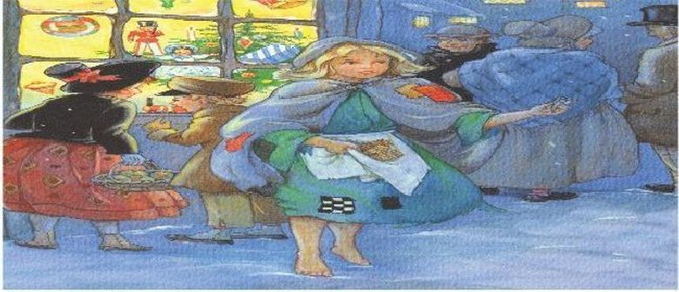
Notes:
https://www.thoughtco.com/little-matchstick-girl-short-story-739298

Slide 26
Shining the Light comes from a personal meeting with the King
and surrendering your gifts for His service

Slide 27
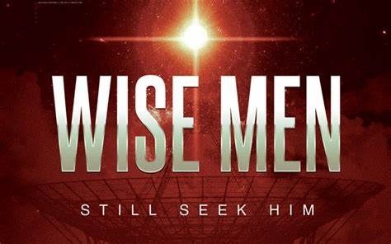
WISE MEN STILL SEEK HIM

