Slide 1
PEACE
On earth!

Slide 2
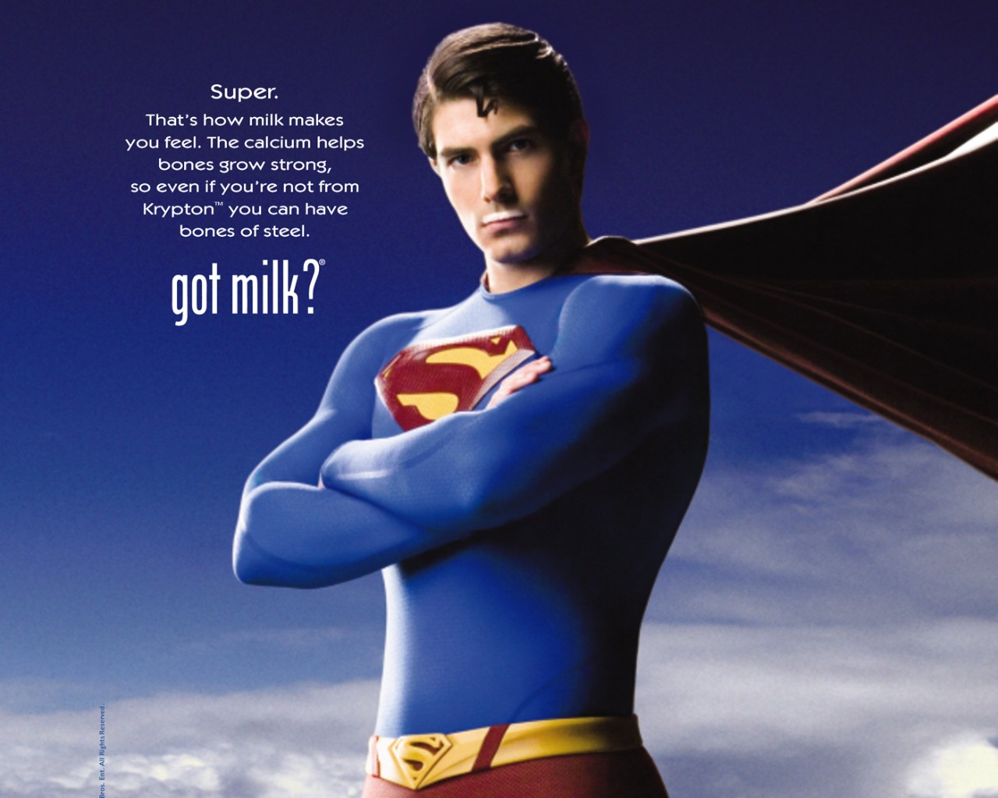
Notes:
In 1993, the ‘got milk’ campaign was launched in the USA to get people to drink milk. They got movie stars, athletes, heartthrobs, even Superman to put on the milk moustache. It worked! That’s what the world needed then. This Christmas…I believe this is what world really needs!

Slide 3
got peace?
Notes:
If you Google search peace organizations, you can find hundreds of organizations that exist for the purpose of promoting world peace. Here are the top 20 organizations according to one website.

Slide 4
International Peace Bureau
Human Rights Watch
Mayors for Peace
United Religions Initiative
United Nations Organization
Nansen International Office for Refugees
Peace Boat
International Crisis Group
World Peace Prayer Society
Nonviolent Peaceforce
The Elders
International Alert
Food Not Bombs
Global Peace Foundation
Global Partnership for the Prevention of Armed Conflict
Pathways to Peace
The Asia Foundation
Flame of Peace
Code Pink
Control Arms Campaign

Slide 5
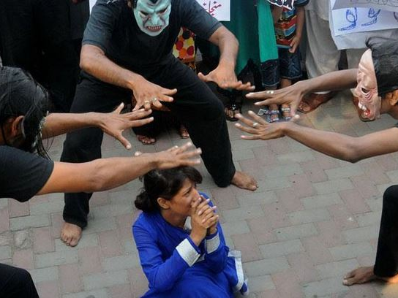
Notes:
Now, if you were to Google search the words ‘violence in the world’, guess how many sites come up in association with the word violence?

Slide 6
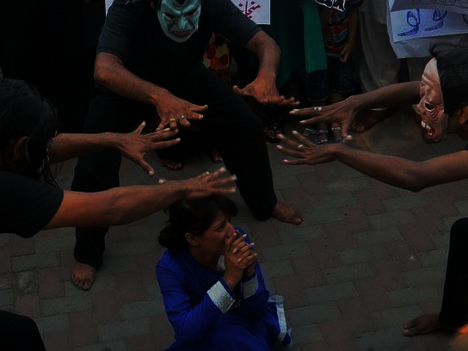
Terrorist Violence
Military Violence
Gang Violence
Gun Violence
Sexual Violence
Workplace Violence
School Violence
Domestic Violence
Notes:
With all these peace organizations in the world, why is there still so much violence in the world?

Slide 7
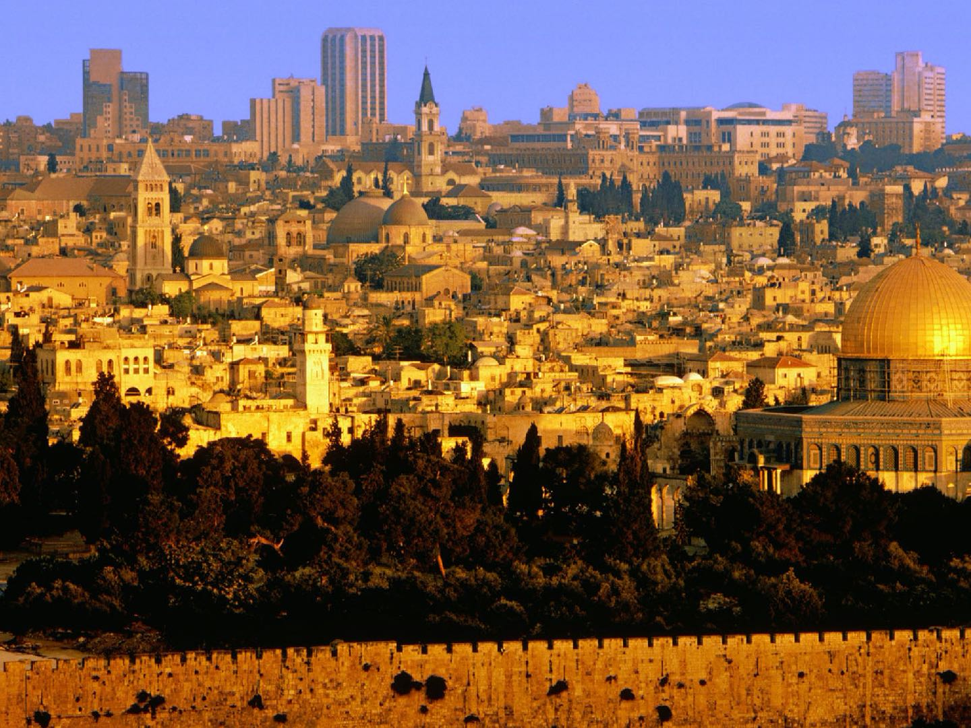
Jerusalem
Notes:
For the purposes of my sharing today, let’s take this city for example. Do you recognize this city? Do you know the name of this city? Yes, it’s Jerusalem. Jerusalem in Hebrew is pronounced Y’ru-shah-lah-yim. (There is no “J” sound in Hebrew.) The name Jerusalem can be divided between two root words: Yara (pronounced as yahr-ah) and shalem. Yara has many meanings, but I draw your attention to these specific meanings: to cast, direct, inform, instruct, show, teacher, teaching and through (as in the way to go through). Shalem means: complete, especially friendly, full, just, made ready, peaceable, perfect(ed), quiet and whole. All Hebrew words either are the root or have a root meaning. The root of Shalem means: to be safe (in mind, body or estate), to be (or make) complete, to make amends, to (make an) end, furnish, full, give again, make good, (re)pay (again), to make (to be at) peace, peaceable, (that is) perfect, make prosperous, recompense, render, make restitution, restore, and surely reward.
When you put Yara and Shalem together as the Hebrew word for Jerusalem and we have a picture of the intent of the Bible in its entirety, of God’s instructions, interactions, and “teaching” to mankind. Does this not sound like the full story of God’s salvation, revealing the very nature and character of the Kingdom of God? You put this all together and we see God’s motive or intention for Jerusalem. It was to be the place where He interacts with men in the ways that define its name. When God interacted with Abraham, this is where Abraham almost sacrificed his son. And just slightly north, this is the same location where Yeshua’s sacrificial death took place. As we approach Christmas, I believe the Christmas story brings to us messages of hope, joy, love, and peace. Today, I would like to focus on PEACE, just as the meaning of Jerusalem, refers to God’s instruction or teaching to mankind to make complete, make amends, make peace, restore.

Slide 8
Isaiah 9:6
For unto us a Child is born, Unto us a Son is given; And the government will be upon His shoulder. And His name will be called Wonderful Counselor, Mighty God, Everlasting Father, Prince of Peace.
Notes:
As we begin our Christmas series, let’s take a look at Isaiah 9:6. Here is the prophecy of the coming Christ. Of God’s many purposes for the coming Christ, one was to bring peace. As the Prince of Peace, His coming would result in peace between God and man, peace within man himself, and peace between man and man. He is the creator of peace, commander of peace, and preserver of peace. He IS our peace, and it will be His peace that keeps our hearts. He is the author and giver of all peace, for the present and into the future.

Slide 9
Luke 2:14
14 “Glory to God in the highest, and on earth peace, goodwill toward men!”
Notes:
Then when Jesus was born and the angels announced His birth, the message was the same. The effect of Jesus’ coming on humankind was peace. One main message of Christmas was that the good-will of God toward men is glory to God in the highest, and peace on the earth. Despite all the bad news, the headlines of wars, nations hating each other, the news from God to everyone, including those who are without loved ones for the very first time, is that peace can be found on earth. Despite all the violence that is happening in this world, the message is still ringing that there is peace on earth. It is the goodwill of God that man may find peace in the midst of all the turmoil that is going on around the world. That begs the question then: Is peace on earth even a possibility? Yes, it is. Is there a clear message? Yes, there is. One of God’s messages for Christmas is that He wants to bring us peace and it is a peace that completes us in three ways.

Slide 10
Colossians 1:19-20
19 For it pleased the Father that in Him all the fullness should dwell, 20 and by Him to reconcile all things to Himself, by Him, whether things on earth or things in heaven, having made peace through the blood of His cross.
Notes:
Let’s look at the first way we are completed by God’s peace. Let’s look at Colossians 1:19-20. [Read verse] God’s ultimate purpose for coming to earth was to reconcile all things to Himself. The Cross made that reconciliation possible. Through faith in Christ, the provision to make peace with God and be reconciled to Him was made available. Furthermore, it was “man-ward” in its direction. It was God reconciling Himself to man. God offered and offers peace to us today. God offers to make peace with us so that we can have peace with him. So, the first way that God’s peace completes us is by allowing us to have peace with Him.

Slide 11
Peace with God
Christ came so that all things should be reconciled to Him.
Reconciliation was extended to us; He made the step to initiate peace with us.
Through faith in Christ there is eternal peace between man and God.
Notes:
His peace allows us have peace with Him. Colossians 1:20 reminds us that He came for the purpose of reconciling all to Himself. Through His work on the cross, we could have peace with God. Romans 5:8 But God demonstrates His own love toward us, in that while we were still sinners, Christ died for us. Christ extended His love and grace to us, to provide an opportunity for reconciliation. And then by placing our faith in Christ, we can not only enjoy peace with God in this life, but we can also enjoy peace with God for eternity.

Slide 12
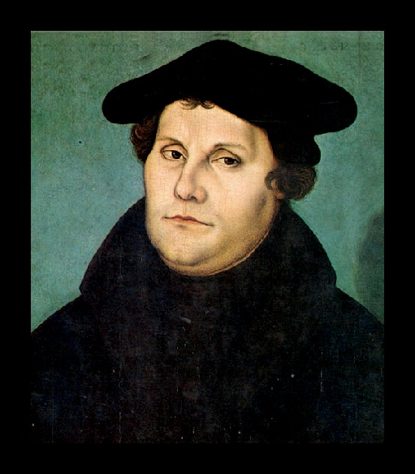
Peace with God
Martin Luther (1483-1546)
Notes:
Martin Luther struggled with the question we all struggle with, “How do I please God and get right with Him?” Luther went to extraordinary measures in order to grant himself the assurance that he was pleasing to God. Joining the Augustinian Monastery was the pinnacle of this pursuit, as he embraced monastic living with a fervor unlike anything his teachers had seen. He would remain in confession for hours, depriving himself almost to the point of death (by sleeping outside in the snow), and himself confessing that his horribly aggressive years as a monk, beating himself and depriving his health shortened the years of his life. Luther wrote, “If there was ever a monk who could have earned his way to heaven through his monkery, I was surely it.” But it was not until later when Luther was sent to Rome, because of his impressive performance as a monk, that his eyes were opened and his journey to an answer began. With the highest of pious expectations, Luther was shattered, angered, and disillusioned when he came to Rome to ﬁnd that the Catholic church was a very human and broken institution of greed and corruption. It was through this experience and his refuting of the Catholic practices, that Luther did ﬁnd the answer to his question and pursuit of pleasing God; we are justiﬁed before God by grace alone through faith in Jesus Christ, not by works or indulgences, but by the receipt of God’s gracious gift.
If it were not for God’s gracious disposition towards us, having mercy on us despite our being enemies of God and sinners (Romans 5:8), all humanity would be condemned and lost. God is gracious, it is who He is. We have earned nothing except death through our sin and rebellion and it is only by God’s merciful love toward us that He sent His Son to pay the price for our sins rather than laying even the slightest ounce of judgement on our heads (Romans 8:32). By grace alone is salvation made available and by which it is given. Faith alone receives God’s gift of grace, and faith itself is a gift from God, leaving no room for the works of boasting men, or those who think they can work for their salvation and redemption (Ephesians 2:8-9). Martin Luther found his peace with God when he realized it was God through His grace, who provided a way of reconciliation. Martin Luther truly found peace with God.

Slide 13
John 14:27
27 Peace I leave with you, My peace I give to you; not as the world gives do I give to you. Let not your heart be troubled, neither let it be afraid.
Notes:
Let’s look at the second way we are completed by God’s peace. Let’s read John 14:27. The world cannot give true peace. Only the Prince of Peace can do that. (Isaiah 9:6) He is only source of true personal and social peace. The world fails because it cannot solve the fundamental source of strife, our fallen human nature. Jesus made peace possible by His work on the Cross. With man’s relationship to God restored, Christ can live in the hearts and lives of those who believe in Him and have submitted to Him. Through the indwelling of His spirit, man can have true peace within, even in the midst of conflicts and trials.

Slide 14
Peace within
Our identity and value is based on our relationship with Him.
Our true peace comes from a settled confidence that we are right with Him.
The peace of Christ secures our composure and dissolves our fears.
Notes:
Through Christ, we can have peace within. Through His work on the Cross, our relationship to Him is restored. Our identity and value is now based on our relationship with Him. Our standing with Him is one of grace and not condemnation. Knowing that we are right with Him, our settled confidence can bring us true peace. Then as we face life challenges and trials, we can experience the supernatural peace of Christ, just like the peace Jesus had when He was awaiting His impending crucifixion.

Slide 15
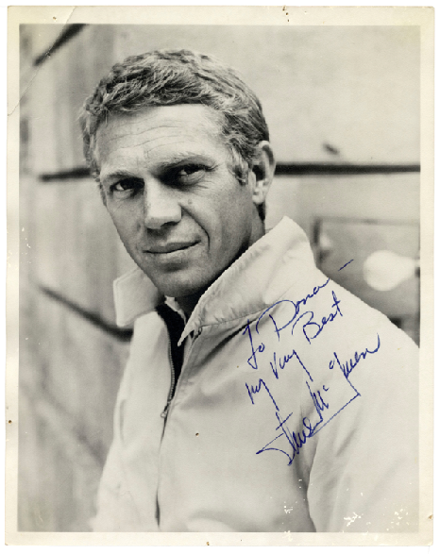
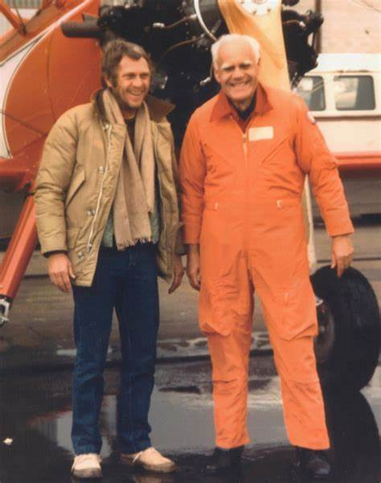
Peace within
Steve McQueen (1930-1980)
Notes:
Steve McQueen once said to his Pastor, Leonard DeWitt, after he had become a Christian and found out some months later that he had cancer, “My only regret is that I was not able to tell more people about what Christ has done for me.” I wanted to right that wrong. Steve McQueen was like a modern-day Solomon. He had it all…the coolest cars, the most beautiful women, worldwide fame, lots of money, and more. He had “been there, done that, and bought the T-shirt.” In fact, he had been the T-shirt! But just like King Solomon of old, who also had massive wealth, fame, and the rest, he came to the realization that it was “all emptiness, like chasing the wind.”
Steve’s faith gave him the strength to face the greatest challenge of his life: cancer. He sought to share his faith with other cancer patients who were in the clinic with him where he was receiving treatment. Steve wanted to live, and he wanted to share his story of what Christ had done for him. Sadly, that was not to be, at least in his lifetime. But the “King of Cool” met the “King of Kings” and had his life changed.
It brought him great peace. He was such a moody and temperamental person who caused chaos on film sets, demanded certain perks, upstaged other actors, drove producers and directors crazy, and suddenly had mellowed. The young McQueen was cocky, selfish, and was willing to step over anyone to get to the top. The older version of McQueen was cooperative, easygoing and a team player.
The lesson of Steve’s life is that he had everything life had to offer and yet he was still empty inside. He drove fast cars and motorcycles, dated and married beautiful women, had stylish clothes, a huge mansion, was idolized by millions and still it wasn’t enough. It was only when he made a decision for Christ that he found true peace and happiness.

Slide 16
Ephesians 2:14
14 For He Himself is our peace, who has made both one, and has broken down the middle wall of separation,
Notes:
Let’s look at the third way we are completed by God’s peace. Let’s read Ephesians 2:14. The early church did not dissolve ethnic distinctions, but it displayed reconciliation, with every believer equally qualified to share in the benefits of salvation and peace. The Jews and the Gentiles were to be united into a new living community. They were all to be “one” in privilege and position toward God. Jesus was the source of restored relationships, not only between an individual and God, but also between individuals. Together, they were to form a new community, the household of God. Christ’s death resulted in peace between Jewish believers and Gentile believers, and peace between Gentile believers and God. The peace of God allows us to make peace with others.

Slide 17
Peace with others
In Christ there is no wall of separation between or with anyone.
We can extend love to others because God has extended His love to us.
We can restore our relationships with others because Christ has restored His relationship with us.
Notes:
Galatians 3:28 Tells us that, There is neither Jew nor Greek, there is neither slave nor free, there is neither male nor female; for you are all one in Christ Jesus. 1 John 4:19 Reminds us, We love Him because He first loved us. Luke 10:27 then tells us to love God, and to love others. Finally, 2 Corinthians 5:18 tells us, Now all things are of God, who has reconciled us to Himself through Jesus Christ, and has given us the ministry of reconciliation, The peace of Christ allows to be at peace with all those around us.

Slide 18
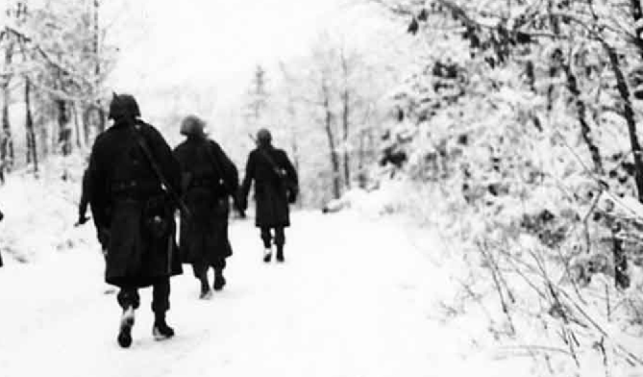
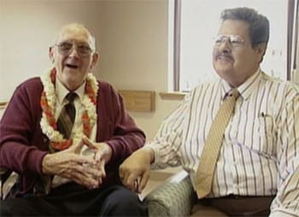
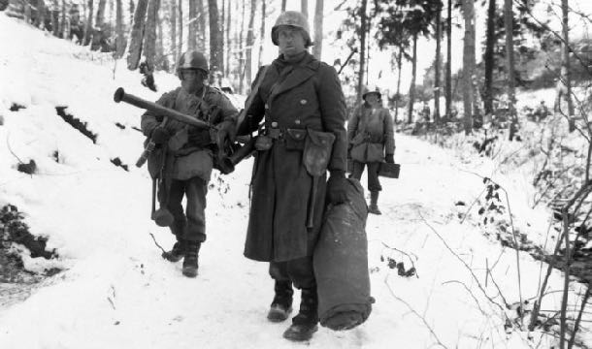
Peace with others
Ardennes Forest
December 24th, 1944
Fritz Vincken and Sgt. Ralph Blank
Notes:
One of the most inspiring stories of peace through Christ among ardent enemies unfolded in a potentially volatile setting. Here is the World War II story of a German mother, her 12 year old son, three American soldiers, and four German soldiers — each of the three parties previously unknown to one another, and how they came together to celebrate Christmas in 1944 in the height of the Battle of the Bulge.
On December 16, 1944, the Germans initiated a massive campaign against the Allies in the Ardennes Forest, a mountainous region extending throughout Belgium, France, and Luxembourg on the Western Front. Over 250,000 German troops mounted a blitzkrieg, attempting to divide the Allies in a major offensive. This set the stage for the Battle of the Bulge. Heavy snowstorms erupted unexpectedly, forever changing the course of this infamous battle and possibly World War II, along with the individual lives of millions of people, and particularly nine individuals one Christmas Eve.
The soldiers were fighting in trenches, on the plains, and on mountain sides. Supplies came to a devastating halt. In thousands of cases, there was no ammunition, no food, no medical help, no shelter, no jackets, no gloves, wet socks and wet worn out boots, no heat, and separation from their platoons! Soldiers were using newspapers and curtains from the wreckage of houses and cabins that were bombed to wrap their feet.
In the Ardennes Forest an American soldier was shot in the upper leg and was bleeding to death. Two fellow American soldiers tried to help him get behind the American line several miles away. Additionally, they were starving and freezing. There was deep snow on the ground, and a heavy snow storm erupted. Disorientation set in. They wandered aimlessly in the Ardennes Forest for three days.
In the distance they saw a cabin and approached it. When they got close to the front door, the two lay their wounded soldier on the snow.
One of the soldiers knocked on the cabin door. Inside was a German mother named Elisabeth Vincken and her 12 year old son Fritz. Because their home in a nearby city had been partially destroyed when Americans bombed the area, Mr. Vincken sent his wife, Elisabeth, and their son, Fritz, to their cabin.
Mr. Vincken remained behind to repair their house and business. His plan was to join them at the cabin when he completed the restoration of their home. He had hoped to be done by Christmas Eve and celebrate Christmas with his wife and son at the cabin. But he did not show up due to the severe snow storm.
Mrs. Vincken heard the knock, opened the door and there stood two American soldiers with weapons, and a third laying in the snow. She did not know English, nor did the Americans know German. But one of the Americans spoke some French, as did Mrs. Vincken. So in broken French and with some sign language, they explained that they were lost, hungry, close to death, and that the soldier laying on the ground was shot and bleeding to death. The American soldiers asked for any assistance in terms of shelter and food for the night, so that they could start in the morning to find the American lines.
There was a German law forbidding German citizens from harboring enemy soldiers. Mrs. Vincken could be shot for providing any assistance. But it was a Holy Night—Christmas Eve. Mrs. Vincken was Lutheran. So Mrs. Vincken let them in. Had Mrs. Vincken turned them away, the American soldiers would not have forced their way in. They would have continued on and hoped to survive the night. Mrs. Vincken was not a sympathizer for the Allied forces at all. She was a Christian and would have assisted anyone needing humanitarian help.
Mrs. Vincken sent Fritz to get six more potatoes from the shed outside and to bring in the rooster. She was going to prepare a Christmas Eve supper for the American soldiers. She went to work in the kitchen preparing supper. Shortly thereafter, there was another knock at the door. So she assumed more American soldiers had arrived needing help.
She opened the door and turned as white as a ghost. There stood four German soldiers with weapons. Mrs. Vincken greeted them. They had lost their way in the forest during the snow storm. Separated from their unit with no food nor warmth for days, they were hungry and feared they might die in the sub-freezing weather with no help in sight. Mrs. Vincken stepped outside and shut the door to speak to the German soldiers privately.
She explained that three American soldiers came and that one was severely wounded and bleeding to death, and that they are inside. She said, “It is the Holy Night and there will be no shooting here.” And she told them that they could eat as much as they wished. She then asked them to give her their weapons. They agreed. She had them lean their weapons against the cabin outside.
She then went inside and shut the door and informed the American soldiers that they had guests, but that they would not be harmed. She explained that there were German soldiers who likewise needed help and that they will come inside for supper and stay the night. She then asked for their weapons, and they agreed. She took the American soldiers’ weapons outside and leaned them against the cabin with the German soldiers’ weapons. Then she invited the German soldiers to come inside.
So there they were. The German soldiers were on one side of the living room and the American soldiers on the other side, facing the opposing side while Mrs. Vincken prepared Christmas Eve supper. The silence was very apparent. Out of the silence emerged the voices of the German soldiers singing the German hymn “Silent Night” in Latin. “Silent Night” was renowned in both German and Latin. The Lutheran denomination in those days held mass in Latin. So German Lutherans often sang in Latin. Then their American brothers in Christ joined in in English. Tears came down the faces of the German and American soldiers as they sang ‘Silent Night.’
The German soldiers brought out of their supplies a flask of wine and a loaf of bread. They shared their wine and bread with the American soldiers. With tears running down their faces they had communion. Then one of the German soldiers began speaking in perfect English to the American soldiers and said he was a medical student. He offered to operate on the wounded American soldier.
For several hours this German soldier operated with no anesthesia. It was such a meticulous and intense operation that his forehead was perspiring. Finally, he got the bullet out and bandaged up the wounded American soldiers. He said that the cold weather prevented infection from spreading. Mrs. Vincken had finished preparing the Christmas Eve supper. She invited them to the table and prayed, “Komm, Herr Jesus, and be our guest.” They had Christian fellowship that Holy Night.
According to Fritz, in an interview in later years, “There were tears in her eyes and as I looked around the table, I saw that the battle-weary soldiers were filled with emotion.”
In the morning, Mrs. Vincken gave them back their weapons and said she would pray for their safety. The German corporal showed the Americans on their own map how to get back behind American lines and gave them his compass. The German soldiers and the American soldiers all shook hands and went in opposite directions. Fritz later recounted, “She asked them to be very careful and told them, “I hope someday you will return home safely to where you belong. May God bless and watch over you.’”
Fritz passed away in 2002. But the historical account of peace through Christ on that legendary Holy Night — Christmas Eve, 1944 — remains as a testimony of the peace that passes understanding which only comes from an abiding relationship with Jesus Christ. Paul the Apostle said, “And the peace of God, which surpasses all understanding, will protect your hearts and minds through Christ Jesus” (Philippians 4:7, MEV).
The power of the cross of Christ brings peace through Christ no matter what your circumstance may be. — ASSIST News

Slide 19
So what?

Slide 20
Ephesians 4:1, 3
1 I, therefore, the prisoner of the Lord, beseech you to walk worthy of the calling with which you were called… 3 endeavoring to keep the unity of the Spirit in the bond of peace.
Notes:
How am I going to be different today after hearing today’s message. Ephesians 4:1,3 tell us [READ VERSE]: To walk worthily, then, would involve behaving in a united way, living in unity with Jewish brethren if one is a Gentile, or vice versa, in the church. Christians must "preserve the unity" between believers that God has established in the church. Paul viewed "peace" as what keeps potential factions together. He had in mind peace between all kinds of diverse groups in the church, the most basic being Jews and Gentiles. This is the message of PEACE from the Christmas story.

Slide 21
Being People of Peace
Be a messenger of peace this Christmas... tell others that story of Christmas is about finding true peace with God and others!
Memorize John 14:27 and recite it whenever difficult times come.
Think of someone you need to reconcile with and restore that relationship today.
SHINING THE LIGHT!
Notes:
Here are our applications! We need to be people of peace!

Slide 22
got peace?
YES!

Slide 24
This Christmas…
Shalom!

