Slide 1
Say a name (person you are praying for)
Nov 24th
Bring a Friend Service!

Slide 2
Cosmetic Surgery
I John 4:20-21
GICF 3 November 2019

Slide 3
What does a perfect nose look like?

Slide 4
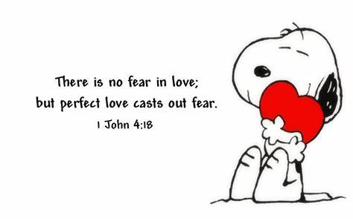
What does perfect love look like?
How does love get perfected?
Time? Experience? Maturity?

Slide 5
Play list
How do we know God lives in us?
What is perfected love?
What test proves love?

Slide 6
I John 4:12-16
No one has seen God at any time. If we love one another, God abides in us, and His love has been perfected in us. ¹³ By this we know that we abide in Him, and He in us, because He has given us of His Spirit. ¹⁴ And we have seen and testify that the Father has sent the Son as Saviour of the world.

Slide 7
I John 4:12-16
¹⁵ Whoever confesses that Jesus is the Son of God, God abides in him, and he in God. ¹⁶ And we have known and believed the love that God has for us. God is love, and he who abides in love abides in God, and God in him.

Slide 8
What should I talk about?
1 John 4:12
No one has seen God at any time. If we love one another, God abides in us, and His love has been perfected in us.

Slide 9
What should I talk about?
How do we know God lives (abides) in us?
His Spirit is in us (v13)
Romans 8:16 The Spirit Himself bears witness with our spirit that we are children of God,
We are witnesses that Jesus is the Saviour sent by God (v14)
We confess Jesus (v15)
We know, believe & remain in the Love God has for us (v16)

Slide 10
What should I talk about?
1 John 4:12
No one has seen God at any time. If we love one another, God abides in us, and His love has been perfected in us.

Slide 11
I John 4:17-19
Love has been perfected among us in this: that we may have boldness in the day of judgment; because as He is, so are we in this world. ¹⁸ There is no fear in love; but perfect love casts out fear, because fear involves torment. But he who fears has not been made perfect in love. ¹⁹ We love Him because He first loved us.

Slide 12
What should I talk about?
What do you mean ‘perfected love’?
Boldness in the day of judgement (v17a)
Revelation 2:11 “… He who overcomes shall not be hurt by the second death.”
Blessed and holy is he who has part in the first resurrection. Over such the second death has no power, … Rev 20:6
As He is, so are we in this world (v17b)
(see next slide)

Slide 13
Do you believe in God? Dennis Prager interviews Jordan Peterson
“Who would have the audacity to claim they believe in God? If they examined the way they lived, who would dare say that?
To believe, to believe in a Christian sense, to have the audacity to claim that, means that you live it out fully. And that’s an unbearable task in some sense,
I try to act as if God exists, because God only knows what you’d be if you truly believed,…That’s the central idea in Christianity, that if you were capable of believing it would be a truly transfiguring event … God only knows what you’d be if you believed.”
Dr. Jordan Peterson is Professor of Psychology, University of Toronto, a clinical psychologist…

Slide 14
What should I talk about?
What do you mean ‘perfected love’?
Boldness in the day of judgement (v17a)
As He is, so are we in this world (v17b)
No fear (v18) [of judgement]
2 Timothy 1:7 For God has not given us a spirit of fear, but of power and of love and of a sound mind
Reflecting love (v19)

Slide 15
I John 4:20-21
If someone says, “I love God,” and hates his brother, he is a liar; for he who does not love his brother whom he has seen, how can he love God whom he has not seen? ²¹ And this commandment we have from Him: that he who loves God must love his brother also.

Slide 16
What’s the test?
“I love God but I hate you” FAIL
“I love God so I love my brother too” PASS
Obedience to the greatest two commandments is the evidence that God lives in us. Living as if God lives in us is the way to perfected love

Slide 17
ONE FINAL DETAIL
A perfect nose would still have trouble walking along the road by itself!

Slide 18
1 John 4:12
No one has seen God at any time. If we love one another, God abides in us, and His love has been perfected in us.

Slide 19
Time for your cosmetic surgery
Is your love becoming perfected?
No fear of judgement after death
Testifying & confessing Jesus
Like Jesus (As he is, so am I)
Love for God
Love for our Christian family
Part of a Christian church family

Slide 20
Shining the Light = living out the character of Jesus in this world through perfected love

Slide 21
Who are you praying for?
Nov 24th
Bring a Friend Service!

