Slide 1
God is love 1 John 4:7-12

Slide 2
DO YOU LOVE GOD?
ARE YOU A LOVING PERSON?
IS GICF A LOVING CHURCH?
HAVE YOU EXPERIENCED LOVE IN GICF?
DO YOU LOVE OTHER BELIEVERS?

Slide 3
There are four forms of Love found in the Bible. They are communicated through four Greek words:
Eros
Storge
Philia and
Agape.

Slide 4
7 Beloved, let us love one another, for love is from God, and whoever loves has been born of God and knows God.
8 Anyone who does not love does not know God, because God is love.
9 In this the love of God was made manifest among us, that God sent his only Son into the world, so that we might live through him.

Slide 5
10 In this is love, not that we have loved God but that he loved us and sent his Son to be the propitiation for our sins.
11 Beloved, if God so loved us, we also ought to love one another.
12 No one has ever seen God; if we love one another, God abides in us and his love is perfected in us. - 1 John 4:7-12

Slide 6
The Web definition of Love states that love is:
-a strong positive emotion of regard and affection
-any object of warm affection or devotion
-have a great affection or liking for
beloved: a beloved person; used as terms of endearment
-to get pleasure from

Slide 7
Biblical definition of love
1 Corinthians 13:4-7
4 Love is patient and kind; love does not envy or boast; it is not arrogant
5 or rude. It does not insist on its own way; it is not irritable or resentful;
6 it does not rejoice at wrongdoing, but rejoices with the truth.
7 Love bears all things, believes all things, hopes all things, endures all things. -

Slide 8
7 Beloved , let us love one another, for love is from God, and whoever loves has been born of God and knows God.
8 Anyone who does not love does not know God, because God is love.
2 Timothy 1:6-7
6 For this reason I remind you to fan into flame the gift of God, which is in you through the laying on of my hands,
7 for God gave us a spirit not of fear but of power and love and self-control.

Slide 9
“God is love” not “love is God”
Romans 5:8
but God shows his love for us in that while we were still sinners, Christ died for us. -

Slide 10
9 In this the love of God was made manifest among us, that God sent his only Son into the world, so that we might live through him.
10 In this is love, not that we have loved God but that he loved us and sent his Son to be the propitiation for our sins.

Slide 11
John 3:18 | AMP says
18 He who believes in Him [who clings to, trusts in, relies on Him] is not judged [he who trusts in Him never comes up for judgment; for him there is no rejection, no condemnation--he incurs no damnation]; but he who does not believe (cleave to, rely on, trust in Him) is judged already [he has already been convicted and has already received his sentence] because he has not believed in and trusted in the name of the only begotten Son of God. [He is condemned for refusing to let his trust rest in Christ’s name.

Slide 12
11 Beloved, if God so loved us, we also ought to love one another.
12 No one has ever seen God; if we love one another, God abides in us and his love is perfected in us.
THE LOVE OF THE FATHER IS AN INCENTIVE TO MUTUAL LOVE AMONG CHRISTIANS.

Slide 13
(1) The primal source of real spiritual love is the Divine nature;
(2) The manifestation of Christly love is an evidence of spiritual regeneration;
(3) The incentive to mutual love among Christians thus becomes all-inspiring and important.

Slide 14
“The importance of each Christian being an exemplification of the reality of God's love and of the gift of His Son is thus seen to be most vital, as constituting one of the leading features in Christian apologetics — an unanswerable argument for the fundamental fact of Christianity.
As love is the most essential force for elevation and regeneration of the human race, Christianity is the only spiritual force yet discovered for that most-devoutly-to-be-wished-for consummation.”
(D. C. Hughes, M. A.)

Slide 15
John 4:20
If anyone says, "I love God," and hates his brother, he is a liar; for he who does not love his brother whom he has seen cannot love God whom he has not seen.
Our zeal should have it’s foundation in love, faith is rendered useless without love.

Slide 16
“And you have patient endurance, and have endured many things because of my name, and have not become weary. But I have this against you: that you have left your first love. Remember therefore from where you have fallen, and repent and do the works you did at first. But if you do not, I am coming to you, and I will remove your lampstand from its place, unless you repent” (Rev 2:3–5).

Slide 17
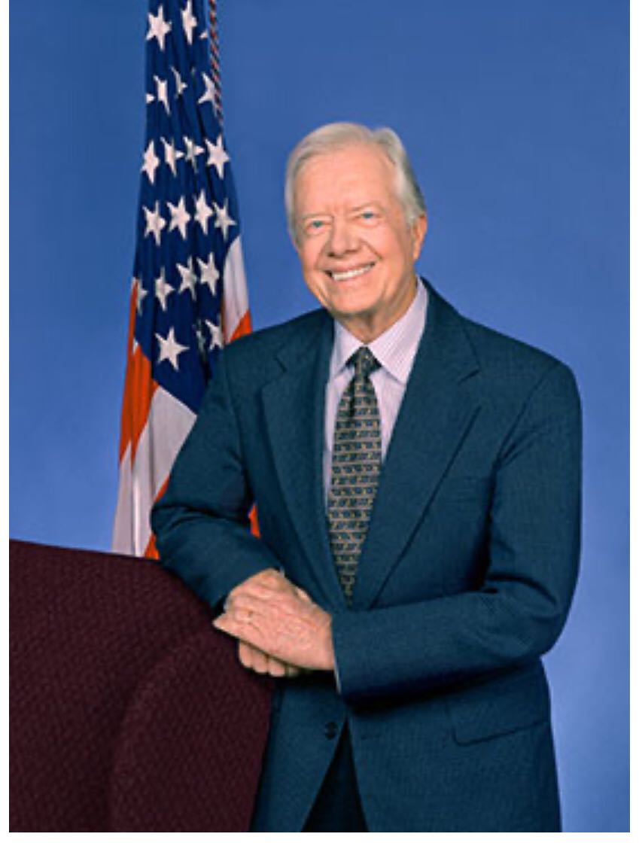
APPLICATION
Matthew 25:35-36
“For I was hungry and you gave me food, I was thirsty and you gave me drink, I was a stranger and you welcomed me, I was naked and you clothed me, I was sick and you visited me, I was in prison, and you came to me.”

Slide 18
Jimmy Cater(James Earl Carter Jr.) is an American politician and philanthropist who served as the 39th president of the United States from 1977 to 1981. A member of the Democratic Party, he previously served as a Georgia State Senator from 1963 to 1967 and as the 76th Governor of Georgia from 1971 to 1975.

Slide 19
He is the founder of Habitat for Humanity. This organization has built affordable houses to families and people that didn’t dream of owning a house in their life more than 40 countries.

