Slide 1
Who Is Jesus?

Slide 2
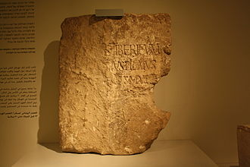
Jesus From Pilate's Perspective

Slide 3
Excerpt from Luke 23
Then the whole assembly rose and led him off to Pilate. 2 And they began to accuse him, saying, “We have found this man subverting our nation. He opposes payment of taxes to Caesar and claims to be Messiah, a king.”
3 So Pilate asked Jesus, “Are you the king of the Jews?”
“You have said so,” Jesus replied.
4 Then Pilate announced to the chief priests and the crowd, “I find no basis for a charge against this man.”
13 Pilate called together the chief priests, the rulers and the people,14 and said to them, “You brought me this man as one who was inciting the people to rebellion. I have examined him in your presence and have found no basis for your charges against him. 15 Neither has Herod, for he sent him back to us; as you can see, he has done nothing to deserve death.
22 For the third time he spoke to them: “Why? What crime has this man committed? I have found in him no grounds for the death penalty.

Slide 4
Jesus is Righteous
2 Corinthians 5:21 - He made Him who knew no sin to be sin on our behalf, so that we might become the righteousness of God in Him.

Slide 5
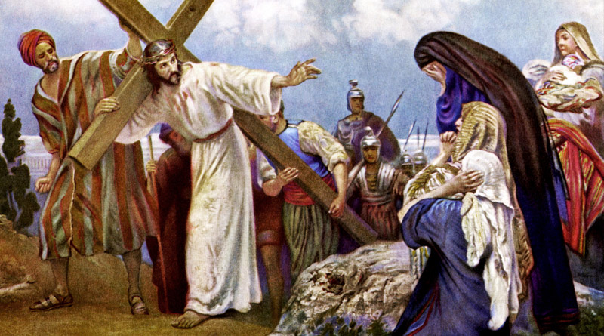
Simon of Cyrene

Slide 6
Jesus from Simon of Cyrene's Perspective
Mark 15:21 - A certain man from Cyrene, Simon, the father of Alexander and Rufus, was passing by on his way in from the country, and they forced him to carry the cross.
Deuteronomy 16:16 - Three times a year all your men must appear before the Lord your God at the place he will choose: at the Festival of Unleavened Bread, the Festival of Weeks and the Festival of Tabernacles. No one should appear before the Lord empty-handed.

Slide 7
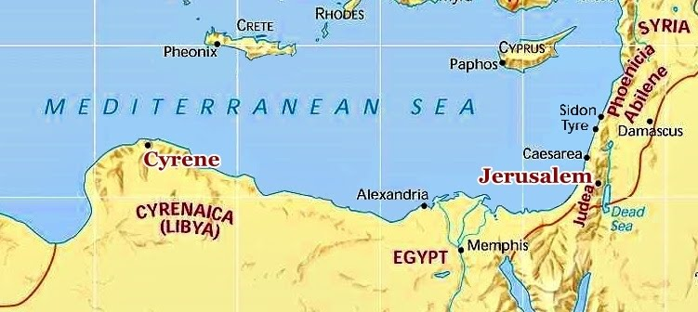
Cyrene – 1260 KM Journey

Slide 8
Jesus is Inconvenient
Simon didn't plan on carrying a cross that day.
His plans were interrupted.
Not everything that seems bad, is bad.

Slide 9
Jesus is Inconvenient, but Providential
Application: We must be willing to face inconvenience for Christ.
Romans 8:18 - I consider that our present sufferings are not worth comparing with the glory that will be revealed in us.

Slide 10
Jesus From the Centurion's Perspective
Mark 15:39 - And when the centurion, who stood there in front of Jesus, saw how he died, he said, “Surely this man was the Son of God!”
He did not wake up planning to believe in Jesus.
He witnessed:
Darkness
Earthquake
Jesus' Response to Mockers
The Way Jesus Died

Slide 11
Jesus is the Son of God
Believing in Jesus is logical.
The first post-cross convert is a Gentile.
Have you accepted Jesus as Son God?

Slide 12
Jesus from the Perspective of Mary Magdalene
John 20:11-18 - 11 Now Mary stood outside the tomb crying. As she wept, she bent over to look into the tomb 12 and saw two angels in white, seated where Jesus’ body had been, one at the head and the other at the foot. They asked her, “Woman, why are you crying?” “They have taken my Lord away,” she said, “and I don’t know where they have put him.” 14 At this, she turned around and saw Jesus standing there, but she did not realize that it was Jesus. He asked her, “Woman, why are you crying? Who is it you are looking for?” Thinking he was the gardener, she said, “Sir, if you have carried him away, tell me where you have put him, and I will get him.” Jesus said to her, “Mary.” She turned toward him and cried out in Aramaic, “Rabboni!” (which means “Teacher”). Jesus said, “Do not hold on to me, for I have not yet ascended to the Father. Go instead to my brothers and tell them, ‘I am ascending to my Father and your Father, to my God and your God.’” Mary Magdalene went to the disciples with the news: “I have seen the Lord!” And she told them that he had said these things to her.

Slide 13
Jesus is Everything
He transformed Mary's life
Mark 2:17 - On hearing this, Jesus said to them, "It is not the healthy who need a doctor, but the sick. I have not come to call the righteous, but sinners."
She hoped to find Jesus' dead body, but found Him alive!

Slide 14
Jesus is Everything
His first post-resurrection appearance was to Mary, a woman.
He called the disciples “brothers” for the first time.
His resurrection is Evidenced by Eyewitnesses.

Slide 15
Jesus' Resurrection is Evidenced by Eye-witnesses
1 Corinthians 15:14 - And if Christ be not risen, then is our preaching vain, and your faith is also vain.
1 Corinthians 15:19 - If only in this life we are having hope in Christ, we are more to be pitied than all men.
False Theories
Swoon Theory
Disciples Stole the Body Theory
Hallucination Theory

Slide 16
Who is Jesus to You?
Jesus is Nearby
Isaiah 55:6 - Seek the Lord while he may be found; call on him while he is near.
Ephesians 2:13 - But now in Christ Jesus you who once were far away have been brought near by the blood of Christ.

Slide 17
Who is Jesus?
Jesus is Righteous
Jesus is Inconvenient (but providential)
Jesus is Son of God
Jesus is Everything
Jesus is Near

