Slide 1
THE CASE FOR CHRIST
1 CORINTHIANS 15: 16-19

Slide 2
1 CORINTHIANS 15: 16-19
“For if the dead are not raised, then Christ has not been raised either. And if Christ has not been raised, your faith is futile.; you are still in your sins. . Then those also who have fallen asleep in Christ are lost. If only for this life we have hope in Christ, we are of all people most to be pitied”.

Slide 3
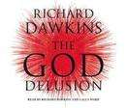
Professor richard dawkins

Slide 4
PROFESSOR RICHARD DAWKINS
“A delusion is something that people believe in despite a total lack of evidence.”
“When one person suffers from a delusion it is called insanity. When many people suffer from a delusion it is called religion.”
“Faith is the great cop-out, the greatest excuse to evade the need to think and evaluate evidence. Faith is the belief in spite of…the lack of evidence”.
“Evidence is the only reason to believe something.”

Slide 5
Antony Flew – world’s leading atheist William Warner – u.s. Cold Case Investigator
“My discovery of the Divine has been a pilgrimage of reason and not faith” (Flew)
“...I had to go where the evidence leads” (Flew)
“I’m not a Christian today because I was raised that way or because it satisfies some need or accomplishes some goal. I am simply a Christian because it’s evidently true”. (Warner)

Slide 6
EVIDENCE ONE: THE TESTIMONY OF FULFILLED PROPHECY
FACT ONE: There are more than 300 prophecies about Jesus Christ written 400 to 1000 years before Jesus was born.
FACT TWO: All these prophecies came true in Jesus Christ.

Slide 7
EVIDENCE ONE: PROPHECY FULLFILLED
EXAMPLES:
King David writes about Jesus 1000 years before Jesus was born.
The prophet Isaiah writes about Jesus about 800 years before Jesus.
Daniel writes about Jesus more than 500 years before Jesus existed.

Slide 8
EVIDENCE ONE: PROPHECY FULFILLED
ISAIAH 7:14 The Lord Himself will give you a sign: the virgin will conceive and give birth to a son, and will call him Immanuel (God with us).
MATTHEW 1:21 She will give birth to a son, and you are to give Him the name Jesus because He will save his people from their sins.
MICAH 5:2 “But you, Bethlehem Ephrathah, though you are small among the clans of Judah, out of you will come for me ,one who will be ruler over Israel, whose origins are from of old, from ancient times.”
MATTHEW 2:1 Now when Jesus was born in Bethlehem of Judaea in the days of Herod the king, behold, there came wise men from the east to Jerusalem

Slide 9
EVIDENCE ONE: PROPHECY FULFILLED
ISAIAH 9:1 Nevertheless, there will be no more gloom for those in distress. In the past He humbled the land of Zebulun and the land of Naphtali, but in the future He will honor the Way to the Sea, beyond the Jordan, Galilee of the Gentiles: 2The people walking in darkness have seen a great light; on those living in the land of the shadow of death, a light has dawned.…
MATTHEW 4:14-16 Leaving Nazareth, He went and lived in Capernaum, which is by the sea in the region of Zebulun and Naphtali, to fulfill what was spoken through the prophet Isaiah: “Land of Zebulun and land of Naphtali, the way to the sea, beyond the Jordan, Galilee of the Gentiles—…

Slide 10
EVIDENCE ONE; PROPHECY FULFILLED
ZECHARIAH 9:1 Rejoice greatly, Daughter Zion! Shout, Daughter Jerusalem! See, your king comes to you, righteous and victorious, lowly and riding on a donkey, on a colt, the foal of a donkey.
MATHHEW 21:6 ⁷ They brought the donkey and the colt and placed their cloaks on them for Jesus to sit on. ⁸ A very large crowd spread their cloaks on the road, while others cut branches from the trees and spread them on the road. ⁹ The crowds that went ahead of him and those that followed shouted,“Hosanna to the Son of David!”

Slide 11
EVIDENCE ONE: PROPHECY FULFILLED
ZECHARIAH 11:12-13 I told them, “If you think it best, give me my pay; but if not, keep it.” So they paid me thirty pieces of silver.¹³ And the Lord said to me, “Throw it to the potter”—the handsome price at which they valued me! So I took the thirty pieces of silver and threw them to the potter at the house of the Lord.
MATTHEW 26:15 Then one of the Twelve—the one called Judas Iscariot—went to the chief priests¹⁵ and asked, “What are you willing to give me if I deliver him over to you?” So they counted out for him thirty pieces of silver

Slide 12
EVIDENCE ONE: PROPHECY FULFILLED
MATTHEW 27: 3 When Judas, who had betrayed him, saw that Jesus was condemned, he was seized with remorse and returned the thirty pieces of silver to the chief priests and the elders. ⁴ “I have sinned,” he said, “for I have betrayed innocent blood.” “What is that to us?” they replied. “That’s your responsibility.”⁵ So Judas threw the money into the temple and left. Then he went away and hanged himself.⁶ The chief priests picked up the coins and said, “It is against the law to put this into the treasury, since it is blood money.” ⁷ So they decided to use the money to buy the potter’s field

Slide 13
Psalm 22 – an entire prophecy about the messiah who would suffer and die
Psalm 22 was written by King David of Israel approximately 1000 years before Jesus was born. This psalm contains about 20 prophecies about the death of the Messiah. How did King David know this?
Psalm 22:1 Messiah would be forsaken – 2 Corinthians 5:21
Psalm 22:1 “My God, My God, why have you forsaken me?” – Matthew 27:46
Psalm 22:2 Darkness falls at this time – Matthew 27:45
Psalm 22:7 They shake their head at Him - Matthew 27:39-44
Psalm 22:14 They pierce his side – John 19:34
Psalm 22:15 He thirsts – John 19:28
Psalm 22:16 His hands and feet are pierced – John 19:34-37
Psalm 22: 17-18 Stripped and stared at – Luke 24:34-35
Psalm 22: 18 They divide his clothes among themselves – John 19:23-24
Psalm 22:22 Resurrection – John 20:17
Psalm 22:31 “It is finished!” – John 19:30

Slide 14
Isaiah 53 – An entire chapter about the life, death and resurrection of jesus christ
Isaiah 53 was written approximately 800 years before Jesus was born. This chapter contains about 20 prophecies alone about the Messiah. How did Isaiah know this?

Slide 15
EVIDENCE ONE: FULFILLED PROPHECY: DANIEL 9:24-27 “70 WEEK PROPHECY”
DANIEL PREDICTED THIS AROUND 540BC. THE PROPHECY STARTS WITH THE EDICT TO REBUILD JERUSALEM UNDER THE PERSIAN KING ARTAXERXES AROUND 457BC.
“Seventy ‘sevens’ are decreed for your people and your holy city to finish transgression, to put an end to sin, to atone for wickedness, to bring in everlasting righteousness, to seal up vision and prophecy and to anoint the Most Holy Place.

Slide 16
EVIDENCE ONE: FULFILLED PROPHECY: DANIEL 9:24-27 “70 WEEK PROPHECY”
²⁵ “Know and understand this: From the time the word goes out to restore and rebuild Jerusalem until the Anointed One, the ruler, comes, there will be seven ‘sevens,’ and sixty-two ‘sevens.’ It will be rebuilt with streets and a trench, but in times of trouble. ²⁶ After the sixty-two ‘sevens,’ the Anointed One will be put to death and will have nothing. The people of the ruler who will come will destroy the city and the sanctuary. The end will come like a flood: War will continue until the end, and desolations have been decreed. ²⁷ He will confirm a covenant with many for one ‘seven.’^{[f]} In the middle of the ‘seven’ he will put an end to sacrifice and offering.

Slide 17
EVIDENCE ONE: FULFILLED PROPHECY DANIEL 9:24-27
THIS IS A COMPLEX PROPHECY.
Begins around 457bc with the Persian King Artaxerxes’ edict to rebuild Jerusalem in 457 BC.
The prophecy is for seventy times seven weeks = 490 years.
The 490 years are divided into 3 parts:
A. Seven sevens to rebuild Jerusalem = 49 years.
B. Sixty two sevens to the Annointed one = messiah = 434 years
C. One year = 7 years. In the middle of the 7 years the Messiah is cut off or killed. He will cause the sacrifices to cease.

Slide 18
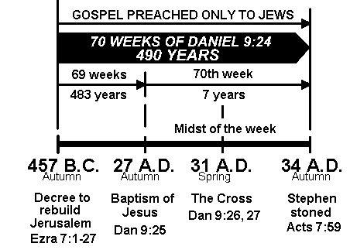
DANIEL 9:24-27 DIAGRAM

Slide 19
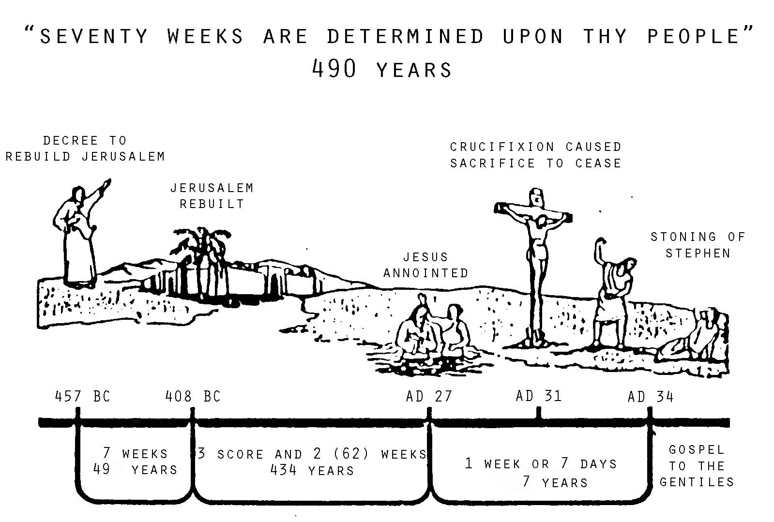
Evidence: fulfilled prophecy daniel 9:24-27 diagram

Slide 20
What is the probability?
Professor Stoner, Chairman of the Departments of Mathematics and Astronomy at Pasadena College used the mathematical principle called the Law of Compound Probability.
His findings were corroborated by the American Scientific Affiliation.
He calculated that for 48 prophecies to come true in this man Jesus Christ by accident or coincidence would be 1 in 10 to the power of 157. That means the chances would be 1 followed by 157 zeros.
Here is the number 1 in 100000000000000000000000000000000000000000000000000000000000000000000000000000000000000000000000000000000000000000000000000000000000000000000000000000000000

Slide 21
Science speaks
In Professor Stoner’s book “Science Speaks”, he said the chances of this happening by chance are:
“This is like covering the entire state of Texas two feet deep in silver dollars marking one of them with an X and telling a blind man to pick up the silver dollar the first time.”

Slide 22
Evidence two: the resurrection of jesus after three days.
The Apostle Paul argued in 1 Corinthians 15 that if Jesus did not rise but was still dead then Christians are the people most to be pitied as they would be the greatest of fools.
Sceptics of the resurrection of Jesus have put forward several theories about what happened to Jesus after He died. Below ae the most common ones.
Theory One: Jesus did not actually die. He fell unconscious and then escaped out of the tomb.
Theory Two: The disciples overpowered the Roman guards and stole the body.
Theory Three: All the disciples hallucinated that they saw Jesus alive.

Slide 23
Theory one: jesus didn’t actually die but escaped the tomb
The Roman guards didn’t realise that Jesus was not dead.
Jesus had been whipped; beaten; pierced in the chest; nailed to the tree; beaten etc
They speared his chest and blood and water came out. How did he survive that?
Joseph of Arimithea and Nicodemus wrapped him in linen and embalmed him in thick ointments. How did he breathe through it all?

Slide 24
Theory one: jesus didn’t actually die but escaped the tomb
Jesus then had to unwrap Himself; push over or roll back (!) the 1-2 ton rock (!!!).
Then amazingly overpower the well-armed Roman guards or secretly escape past the sleeping Roman guards (a crime punishable by death) after pushing the 1-2 ton rock.
He then gets back to the frightened disciples in his greatly weakened state and says I’m alive!” and then they go around the empire risking their life proclaiming Jesus had risen from the dead! Does this make sense?

Slide 25
Theory One: Jesus didn’t die but escaped.

Slide 26
Theory two: the disciples stole the body!
The terrified disciples who had just run away on the night Jesus was betrayed suddenly became very brave.
The disciples overpowered the well-armed, well-trained professional Roman soldiers guarding the tomb.
The disciples pushed back the 1-2 ton rock; got Jesus dead body; and then hid it in another secret, undiscovered tomb.
The disciples then risk their lives; livelihoods; family members; and possessions by preaching an obvious mistruth that Jesus was alive.
Does this make sense? Peter denied Jesus three times; he was so chicken of being caught out he was a believer. The other disciples ran away.

Slide 27
Theory two: the disciples stole the body

Slide 28
Theory two: the disciples stole the body under the roman soldiers’ noses

Slide 29
Theory three: the disciples (and everybody else who saw him) hallucinated the same thing.
The disciples were so distraught that they all (all 11 of them!) hallucinated that Jesus was alive and had spoken and ate with them over 40 days.
However, the Gospels all say that they met, talked and ate with Jesus several times over 40 days. And that Jesus had been seen on the flesh by other disciples.
On one occasion Jesus was seen by 500 people at one time. Did they all hallucinate the same thing?
Why didn’t the Jewish authorities and Roman guards just show the dead body of Jesus to quell the belief that Jesus was actually alive?

Slide 30
Theory three: they all dreamed it up. So why not show the body to stop the rumor?

Slide 31
What does jesus and the cross actually tell us about yourself and about God?
Why is Jesus actually doing on the cross? Why is he there?
The cross tells us deep things about God and about ourselves. Some we don’t want to know. First, the cross tells us how serious sin is to God.

Slide 32
How serious is sin to god? Look at the cross and you can tell.
“No proof of the fullness of sin ….. Is so overwhelming and unanswerable as the cross and passion of our Lord Jesus Christ and the whiole doctrine of His substitution atonement. Terribly black must that guilt be for which nothing but the blood of the Son of God could make satisfaction. Heavy must that weight of human sin be that made Jesus groan and sweat drops of blood in agony at Gethsemane and cry at Golgotha, “My God, My God, why have you forsaken Me?” (Ryle)
“Never was sin to be more abominably sinful, than when the burden of it was upon the shoulders of the Son of God. Would you, then see the true demerit of sin? Take the measure of it from the cross of Christ.” (Owen)

Slide 33
The cross tells us about god’s justice and god’s holiness.
There are only 2 places where your sin can be – either they are on you or they are on Christ.
Sexual sins: sleeping with your boyfriend/girlfriend, viewing pornography
Sins of pride and selfishness
Sins of lying, slandering, swearing
Disobeying your parents, teachers etc.
Stealing (eg. Not paying your taxes etc.)
Drunkenness
Anger, rage, malice
Every sin is known by God. None are hidden. None are forgotten by God.
Ezekiel 18:20: “The soul that sins shall die.”

Slide 34
The cross tells us about god’s love for sinners
John 3:16 For God so loved (insert your name here) that He gave His one and only Son so that (insert your name here) believes in Him shall not perish but have everlasting life.
John 11: 25: “I am the resurrection and the Life. Whoever believes in me shall live., even though they die. And whoever lives in believing in me shall never die.”
You may not value your own souls or body but God does.
“However lightly you may esteem your own souls, I know our Lord has set an unspeakable value on them. He thought them worthy of His most precious blood.” (Whitfield)

Slide 35
What IS A believer?
They trust explicitly in Jesus Christ. To save them They wrap their arms, so to speak, around Jesus’ legs at the cross and take hold of Him.
“Upon a life I did not live, upon a death I did not die; another’s life, another’s death I stake my whole eternity.” They do not trust in their own goodness or works.
They are sorry/repentant for their sins. They realize that it was their own sins that caused Jesus to die and are sorrowful for their sins. They turn over a new leaf. They go in a new direction. They look up to Jesus’ face on the cross and realize it was their sins that held Jesus there.
”Surely no rebel can expect the king to pardon his treason while he remains in open revolt”.
A genuine believer is like a two-sided coin. They trust in Jesus alone. On the other side, they are sorry for their sins and repents. The two must go together.

Slide 36
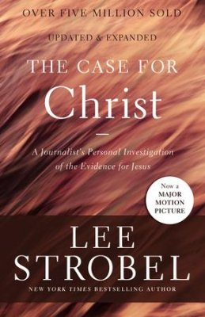
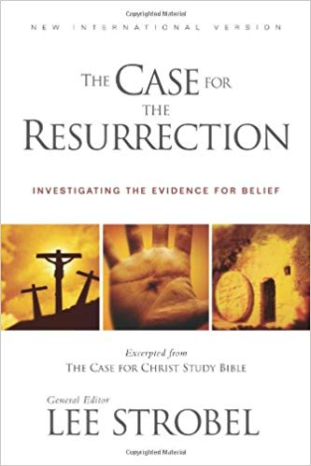
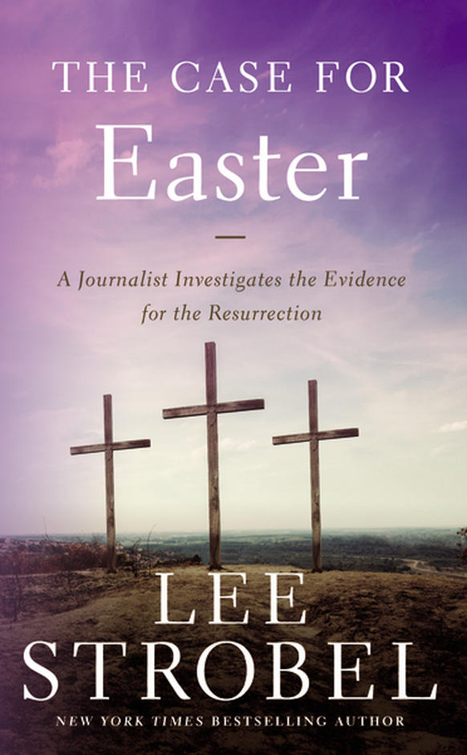
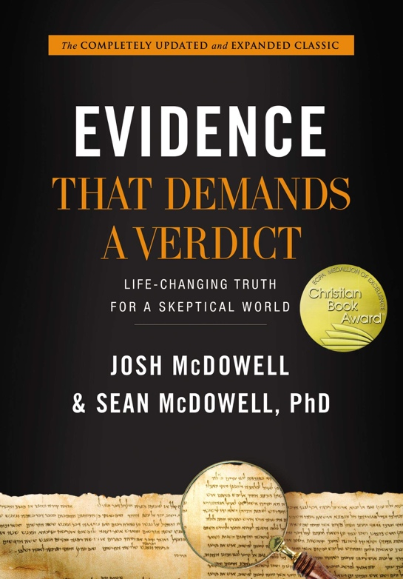
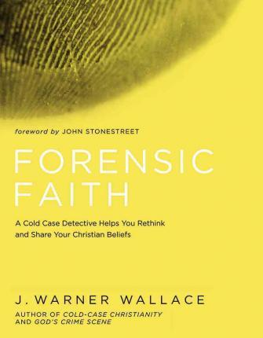
PERHAPS YOU WANT TO KNOW MORE. IF SO THEN I ENCOURAGE YOU TO GET AND READ THE FOLLOWING BOOKS.

