Slide 1
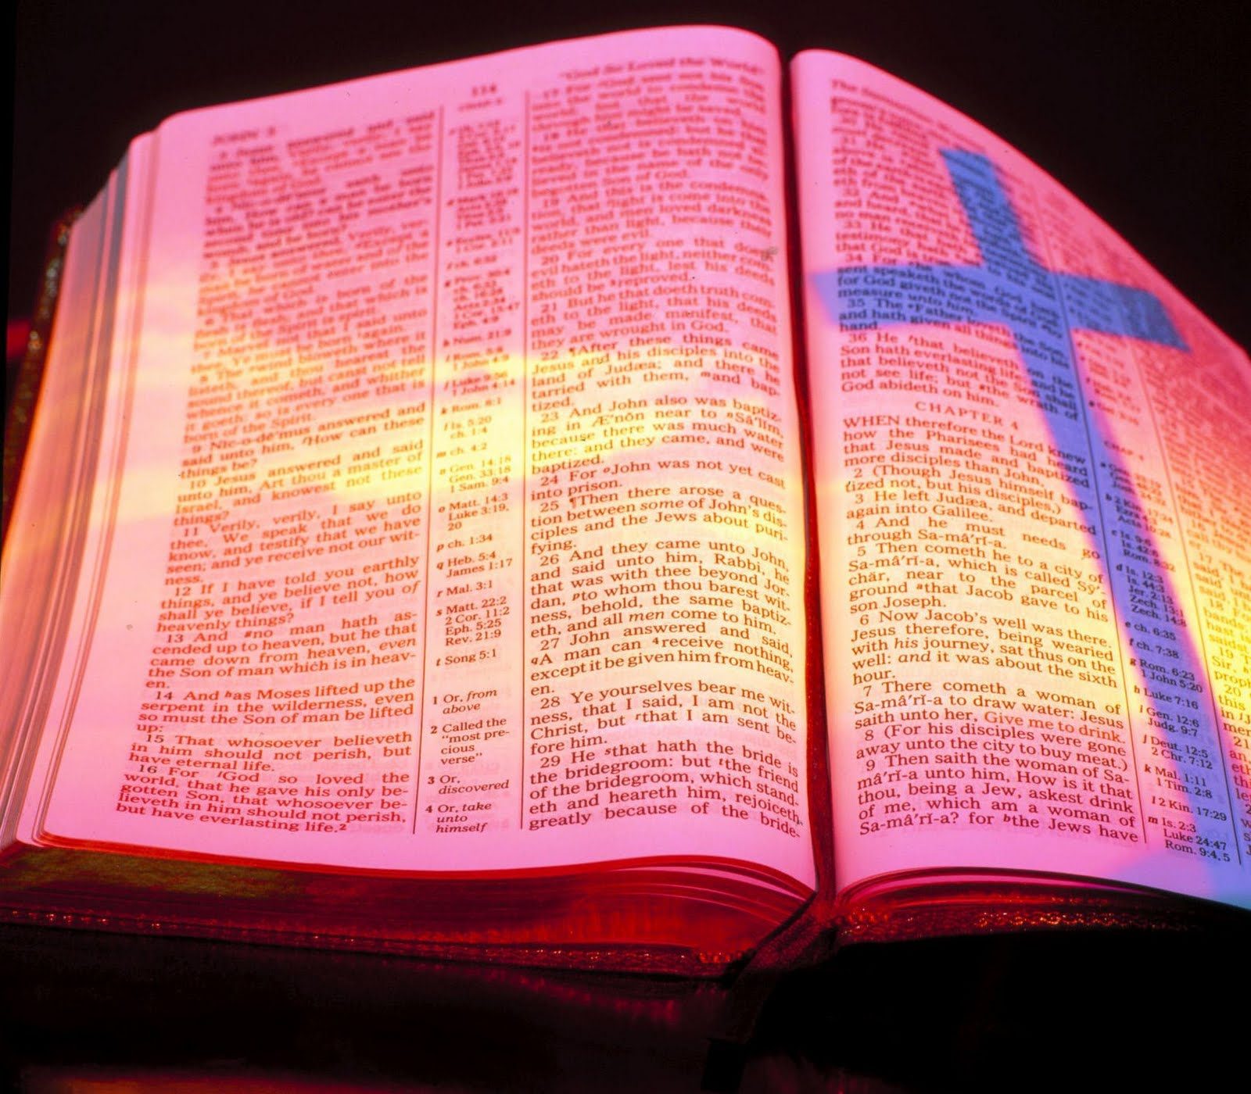
International Day of the Bible #BibleCelebration
18th November 2018

Slide 2
Cunning Fables or the Sure Word?
II Peter 1:16-21

Slide 3
2 Peter 1:16-21 (RAV)
¹⁶ For we did not follow cunningly devised fables when we made known to you the power and coming of our Lord Jesus Christ, but were eyewitnesses of His majesty. ¹⁷ For He received from God the Father honour and glory when such a voice came to Him from the Excellent Glory: “This is my beloved Son, in whom I am well pleased.” ¹⁸ And we heard this voice which came from heaven when we were with Him on the holy mountain.

Slide 4
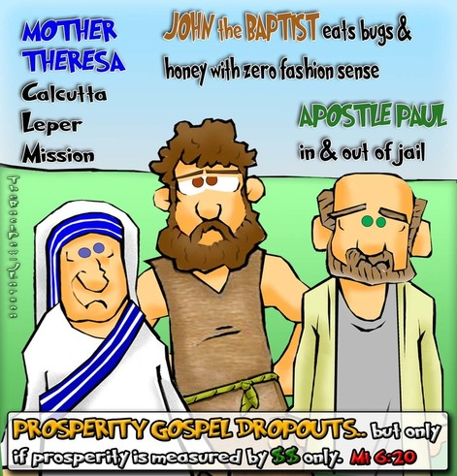
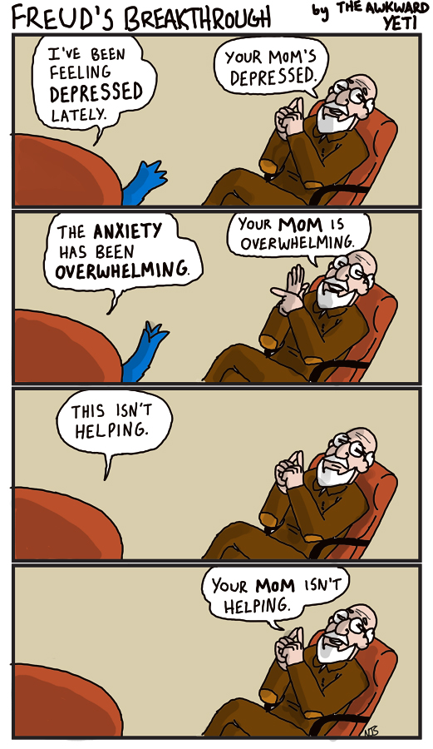
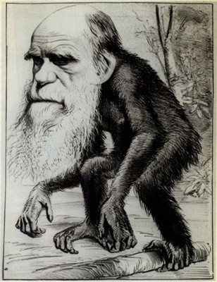
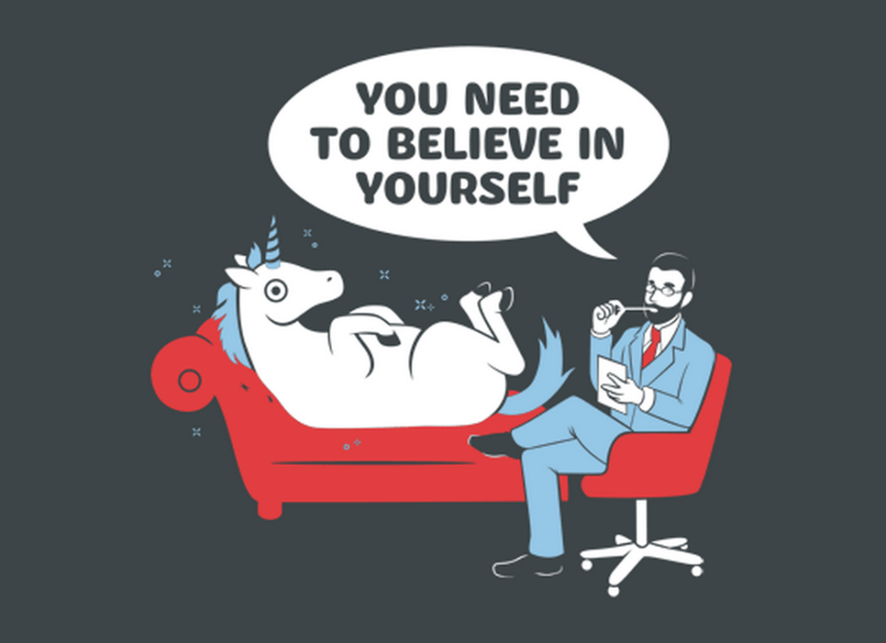
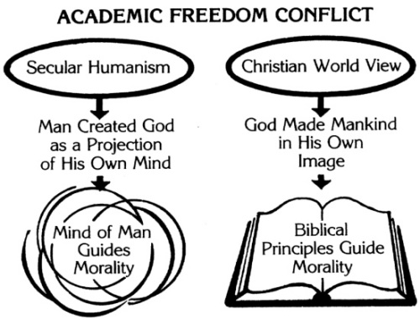
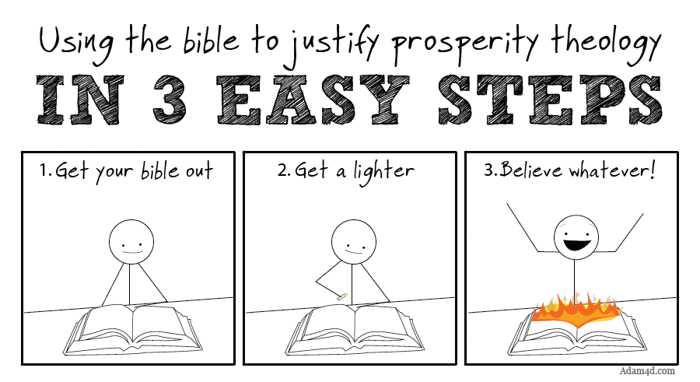
1. Cunning Fables
Evolution
No accountability – the fittest survive
Secularism
Education (& government) without religion (and God) is better
Freudianism
Blame your mother, no personal guilt; no sin
Prosperity Gospel
Real Christians are never poor or sick
Notes:
Secular – (from Latin) this present age, this world, as opposed to the eternal ‘religious world’
The liberation of man from religious and metaphysical tutelage, the turning of his attention away from other worlds and towards this one
Would you put your child in a muslim school? Buddhist school? Secular humanistic school?

Slide 5
2 Peter 3:16
There are some things in them [Paul’s inspired writings] that are hard to understand, which the ignorant and unstable twist to their own destruction, as they do the other Scriptures.
Don’t go following after ‘prophecies’ or ‘winds of doctrine’

Slide 6
2. What did Jesus receive?
Glory & Honour (v17)
The Father’s pleasure (v17)
A Name above every name (Phil 2:5ff)

Slide 7
2 Peter 1:16-21 (RAV)
¹⁹ We also have the prophetic word made more sure, which you do well to heed as to a light that shines in a dark place, until the day dawns and the morning star rises in your hearts; ²⁰ knowing this first, that no prophecy of Scripture is of any private interpretation, ²¹ for prophecy never came by the will of man, but holy men of God spoke as they were moved by the Holy Spirit.

Slide 8
3. What did we receive?
Eye witness accounts (v16)
God’s own audible testimony (v18)
The prophetic word made more sure (v19) – God’s full written word; the light
Not to mention the many who have died so we can have the Bible in our own languages
Not to mention God’s personal voice that called you
Not to mention the Holy Spirit's presence to help us understand it. I John 1:20

Slide 9
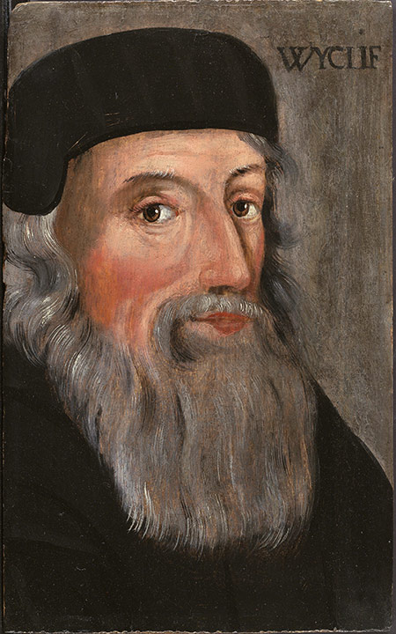
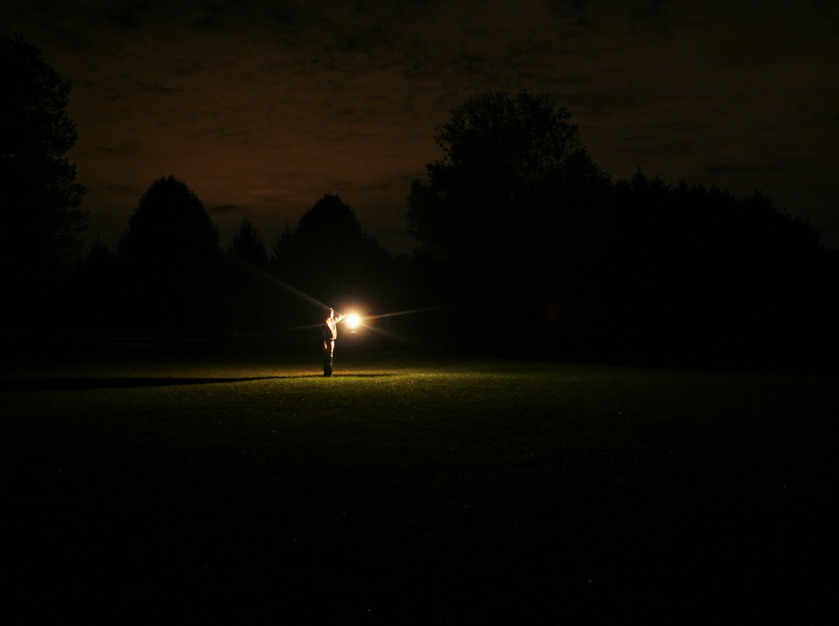
Cunning Fables or the Sure Word What should we do?
Conclusion
…which you do well to heed as to a light that shines in a dark place, until the day dawns and the morning star rises in your hearts;
Heed (v19)
= Do the Word
James 1:22
Hide God’s Word in your heart
Ps 119:11
Transformed by renewing of your mind
Rom 12:2
Notes:
Cleaned by the washing of the Word John 15:3
Morning star of the reformation (John Wycliffe)

Slide 10
Year of the Bible
In the United States, 1983 was designated as the national Year of the Bible by President Ronald Reagan. The law acknowledged a "national need to study and apply the teachings of the Holy Scriptures."
"Can we resolve to teach, learn & try to heed the greatest message ever written, God's Word?" Reagan asked. "Inside its pages lie all the answers to all the problems that man has ever known."

Slide 11
Living in the Kingdom means living by the Book!
International Day of the Bible #BibleCelebration
Post the Bible verse you will try to live out this week

Slide 12
Living in the Kingdom means living by the Book!

