Slide 1
Luke 1:26-38
26 Now in the sixth month the angel Gabriel was sent by God to a city of Galilee named Nazareth, 27 to a virgin betrothed to a man whose name was Joseph, of the house of David. The virgin’s name was Mary. 28 And having come in, the angel said to her, “Rejoice, highly favored one, the Lord is with you; blessed are you among women!”

Slide 2
Luke 1:26-38
29 But when she saw him, she was troubled at his saying, and considered what manner of greeting this was. 30 Then the angel said to her, “Do not be afraid, Mary, for you have found favor with God. 31 And behold, you will conceive in your womb and bring forth a Son, and shall call His name JESUS. 32 He will be great, and will be called the Son of the Highest; and the Lord God will give Him the throne of His father David. 33 And He will reign over the house of Jacob forever, and of His kingdom there will be no end.”

Slide 3
Luke 1:26-38
34 Then Mary said to the angel, “How can this be, since I do not know a man?”
35 And the angel answered and said to her, “The Holy Spirit will come upon you, and the power of the Highest will overshadow you; therefore, also, that Holy One who is to be born will be called the Son of God. 36 Now indeed, Elizabeth your relative has also conceived a son in her old age; and this is now the sixth month for her who was called barren. 37 For with God nothing will be impossible.”
38 Then Mary said, “Behold the maidservant of the Lord! Let it be to me according to your word.” And the angel departed from her.

Slide 4
Matthew 2:1-12
1 Now after Jesus was born in Bethlehem of Judea in the days of Herod the king, behold, wise men from the East came to Jerusalem, 2 saying, “Where is He who has been born King of the Jews? For we have seen His star in the East and have come to worship Him.”
3 When Herod the king heard this, he was troubled, and all Jerusalem with him. 4 And when he had gathered all the chief priests and scribes of the people together, he inquired of them where the Christ was to be born.

Slide 5
Matthew 2:1-12
5 So they said to him, “In Bethlehem of Judea, for thus it is written by the prophet:
6 ​‘​But you, Bethlehem, in the land of Judah,
​​Are not the least among the rulers of Judah;
​​For out of you shall come a Ruler
​​Who will shepherd My people Israel.’ ”

Slide 6
7 Then Herod, when he had secretly called the wise men, determined from them what time the star appeared. 8 And he sent them to Bethlehem and said, “Go and search carefully for the young Child, and when you have found Him, bring back word to me, that I may come and worship Him also.”

Slide 7
9 When they heard the king, they departed; and behold, the star which they had seen in the East went before them, till it came and stood over where the young Child was. 10 When they saw the star, they rejoiced with exceedingly great joy. 11 And when they had come into the house, they saw the young Child with Mary His mother, and fell down and worshiped Him. And when they had opened their treasures, they presented gifts to Him: gold, frankincense, and myrrh.

Slide 8
12 Then, being divinely warned in a dream that they should not return to Herod, they departed for their own country another way.

Slide 9
Divine Appointments
When God interrupts your life

Slide 10
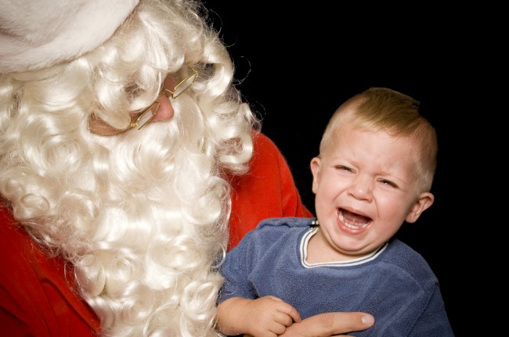
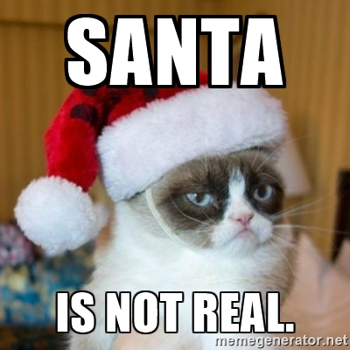
A word from our sponsor

Slide 11
Luke 2:8-14
8 Now there were in the same country shepherds living out in the fields, keeping watch over their flock by night. 9 And behold, an angel of the Lord stood before them, and the glory of the Lord shone around them, and they were greatly afraid. 10 Then the angel said to them, “Do not be afraid, for behold, I bring you good tidings of great joy which will be to all people. 11 For there is born to you this day in the city of David a Savior, who is Christ the Lord. 12 And this will be the sign to you: You will find a Babe wrapped in swaddling cloths, lying in a manger.”

Slide 12
Luke 2:8-14
13 And suddenly there was with the angel a multitude of the heavenly host praising God and saying:
​14 ​​“Glory to God in the highest, and on earth peace, goodwill toward men!”

Slide 13
Luke 2:15-20
¹⁵ So it was, when the angels had gone away from them into heaven, that the shepherds said to one another, “Let us now go to Bethlehem and see this thing that has come to pass, which the Lord has made known to us.” And they came with haste and found Mary and Joseph, and the Babe lying in a manger.

Slide 14
Luke 2:15-20
Now when they had seen Him, they made widely known the saying which was told them concerning this Child. And all those who heard it marveled at those things which were told them by the shepherds. But Mary kept all these things and pondered them in her heart. Then the shepherds returned, glorifying and praising God for all the things that they had heard and seen, as it was told them.

Slide 15
Divine Appointments
What would you like for Christmas if you could have anything?
Notes:
What would you like for Christmas if you could have anything?

Slide 16
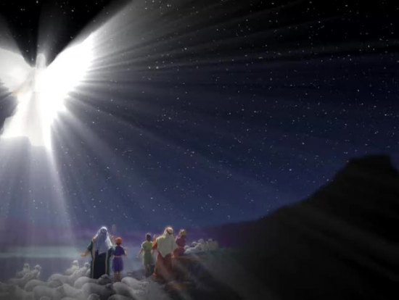
1. Shepherds
RESPONSE
Fear, Luke 2:9
Wonder: “Let's go and see” V15
Shared the good news V17
Praised God V20
Notes:
What are the chances of this divine appointment?
Out in the fields, unaware, not expecting anything out of the ordinary. God interrupted!

Slide 17
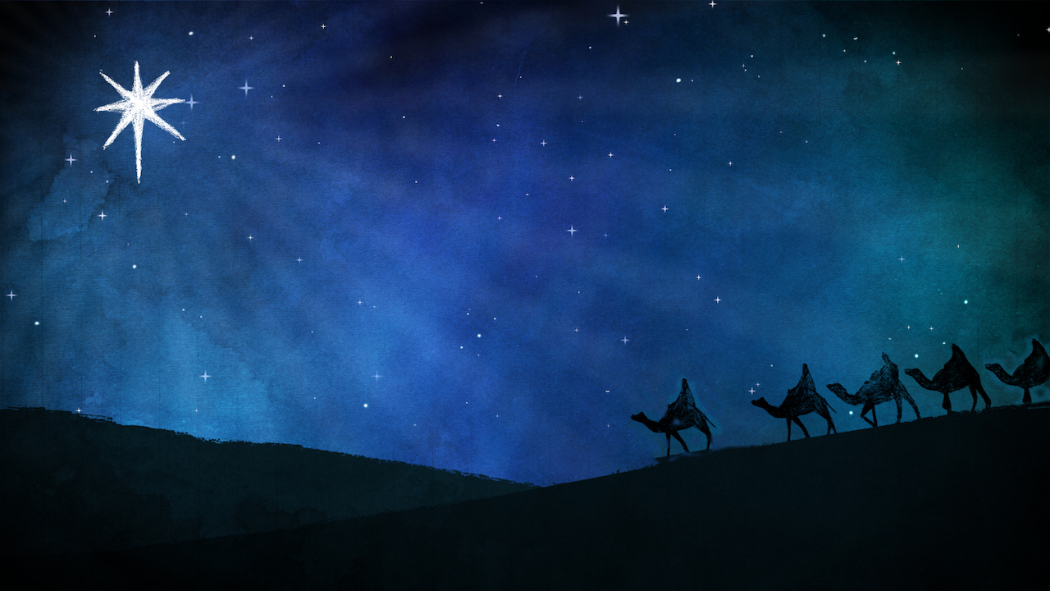
2. Wise men
RESPONSE
saw the star, believed, acted (travelled far )
worshipped, gave HIM gifts
obeyed the dream
Notes:
What are the chances?
Expecting, but far away.
God interrupted and it made them take a long trip!

Slide 18
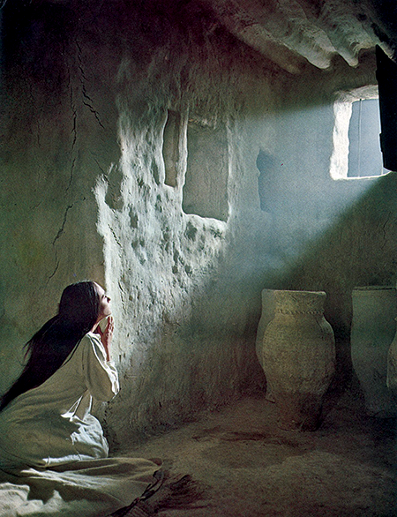
3. Mary
RESPONSE
Troubled Luke 1:29
How can this be? v34
Obedient Luke 1:38a
What did Mary want? Luke 1:38b
Notes:
What were the odds? Young, engaged but not married, fiancé who would be able to stand an unbelievable story of pregnancy, hoping?
God interrupted!

Slide 19
Others
Herod – troubled & exceedingly angry
Anna – Gave thanks to the Lord
Simeon – my eyes have seen your salvation
Notes:
God interjects himself into human affairs in unexpected ways and on his own time schedule

Slide 20
Others
YOU
What do you want for Christmas? Luke 1:37
What would Jesus want? Luke 2:14, Luke 1:38
Notes:
What do you want for Christmas? Luke 1:37
What would Jesus want? Luke 2:14

Slide 21
Have you had a divine appointment?
’Be it unto me according to your word’
1. See the wonderful blessing that it is!
2. Pass it on! - Praise God, worship, travel far, tell others, love God
Notes:
It’s the greatest interruption you can have in life!

Slide 22
The greatest divine appointment!
Notes:
The greatest divine appointment!

